Slide 1
W4111 – Introduction to Databases Section 001, V01, Spring 2025 Lecture 1: Introduction and Foundational Concepts
COMSW4111_002_2025_1 - INTRODUCTION TO DATABASES © Donald F. Ferguson, 2025

Slide 2
To Cover
ChartDB (https://chartdb.io)
Bolt (https://bolt.new)
LucidChart

Slide 3
Waitlists and Enrollments
Faculty do not manage waitlists for some courses, including W4111.
The academic admin staff in the CS Department manages the waitlist, priorities and enrollment.
You should contact advising email:
ug-advising@cs.columbia.edu, ms-advising @cs.columbia.edu or phd-advising @cs.columbia.edu

Slide 4
Contents

Slide 5
Contents
Course overview:
Instructor and TAs
Course objectives and content
Homework, exams, grading
Introductory concepts:
Data and databases
Course overview, objectives and content
Homework, exams, grading
Resources and environment
Web applications, ipython data science projects
Introduction to
Entity Relationship Model, ER Diagrams
Foundational Relational Model and Algebra
Relational Database Management Systems and Structured Query Language
Homework assignments HW0 and HW 1

Slide 6
Course Overview

Slide 7
Instructor and TAs

Slide 8

About Your Instructor
38 years in computer science industry:
IBM Fellow.
Microsoft Technical Fellow.
Chief Technology Officer, CA technologies.
Dell Senior Technical Fellow.
CTO, Co-Founder, Seeka.tv.
Ansys (current):
Ansys Fellow, Chief SW Architect;
VP/GM, Cloud, AI, Solutions and Developer Enablement BU (CASEBU)
Academic experience:
BA, MS, Ph.D., Computer Science, Columbia University.
Approx. 19 semesters as an Adjunct Professor.
Professor of Professional Practice in CS (2018)
Courses:
E1006: Intro. to Computing
W4111: Intro. to Databases
E6998, E6156: Advanced Topics in SW Engineering (Cloud Computing)
Approx. 65 technical publications; Approx. 12 patents.
Personal:
Two children:
College Sophomore.
2019 Barnard Graduate.
Hobbies:
Krav Maga, Black Belt in Kenpo Karate.
Former 1LT, New York Guard.
Bicycling.
Astronomy.
Languages:
Proficient in Spanish.
Learning Arabic.
I have taught some version of this class 10 times.

Slide 9


TAs
Head TA: Karla Zuniga (knz2105@columbia.edu)
One
Two
Three
Aditi Chowdhuri (anc2207@columbia.edu)
One
Two
Three
Gil Laham (gl2736@columbia.edu)
One
Two
Three

Slide 10

TAs
Pranitha Natarajen (pn2435@columbia.edu)
One
Two
Three
Yuehui Ruan (yr2453@columbia.edu)
One
Two
Three
Juanita Santofimio (js5972@columbia.edu)
One
Two
Three

Slide 11
Course Overview, Objectives and Content

Slide 12
The Course
From the new/pending Columbia University Bulletin "Prerequisites: COMS W3134, COMS W3136, or COMS W3137; or the instructor's permission. The course covers what a database system is, how to design databases effectively and in a principled manner, how to query databases, and how to develop applications using databases: entity-relationship modeling, logical design of relational databases, relational algebra, SQL, database application development, database security, and an overview of query optimization and transaction processing. Additional topics generally include NoSQL, graph, object-relational, and cloud databases, as well as data preparation and cleaning of real-world data. The course offers both programming and non-programming paths for homework and projects, to accommodate students with different programming skills and backgrounds."
Prerequisites:
COMS W3134, COMS W3136, or COMS W3137 are data structures classes. All of these courses require extensive programming, in Java.
A course in data structures is helpful for this section of W4111 but not essential. I waive the requirement.
We will help you with any data structures knowledge you lack.
Programming in/for this class:
There will be a "non-programming" option, which we will discuss below.
For students who want to take the programming track, we will use Python. I will provide motivation for choosing Python below.

Slide 13
Course Objectives
Have fun, learn a lot and come to appreciate and enjoy some amazing technology. Data and databases have and will change the world.
Provide a foundation that allows you to succeed in future courses. This is an introduction to databases. The technology is crucial for future courses
Big data, data analysis, data science
Advanced database classes
Machine learning
Numerical and data analytics in operations research, engineering, economics, finance, life sciences, financial engineering, medicine, etc.
Enable you to successfully apply the technology in your work and profession.
Have cool stuff to talk about on interviews and in your resumes.

Slide 14
The Course – Value and my Perspective
This course is foundational, and will teach you the core concepts in
Data modeling
Data model implementation; Data manipulation.
Different database models and database management systems.
Implementation and architecture of data centric applications and database management systems.
ANY non-trivial application
Requires a well-designed data model.
Implements a data model and manipulates data.
Uses a database management system.
Understanding databases and database management is core to the “hottest fields” in computer science, e.g.
Data science
Machine learning
Intelligent (Autonomous) systems
Internet-of-Things
Cybersecurity
Cloud Computing
Database, database application, etc. skills are increasingly central to many disciplines, including:
Economics.
IEOR, financial engineering.
Mechanical and electrical engineering.
Medicine, pharmaceuticals
...
University courses on databases sometimes focus on theory and abstract concepts. This course will cover theory, but there will be an increased emphasis on:
Practical, hands-on applications of databases.
Patterns and best practices.
Developing and understanding database centric applications.
Using databases and various tools for data analysis, visualization and insight.
Personal perspective
A large percent of my career has been spent figuring out or leading teams that figured out how to model, implement and manipulate data.
I have used the information in this class more than anything else I have learned.
This will likely be true for you.

Slide 15
Surprising Example
Example: This is a photo of me using a database during COVID-19 mobilization.
Match service members
To JTF-HQ requests for personnel
Based on assignment needs
And service member
Skills
Availability
Tracked in a DBMS.
The hardhat is because DB usage can be very dangerous 😱.
No joking: I had to build an application that used:
Relational DBMS.
Python, Jupyter Notebook.
Google Sheets with Apps Script.
Google Forms.
This course’s technology and these skills are surprisingly applicable.

Slide 16
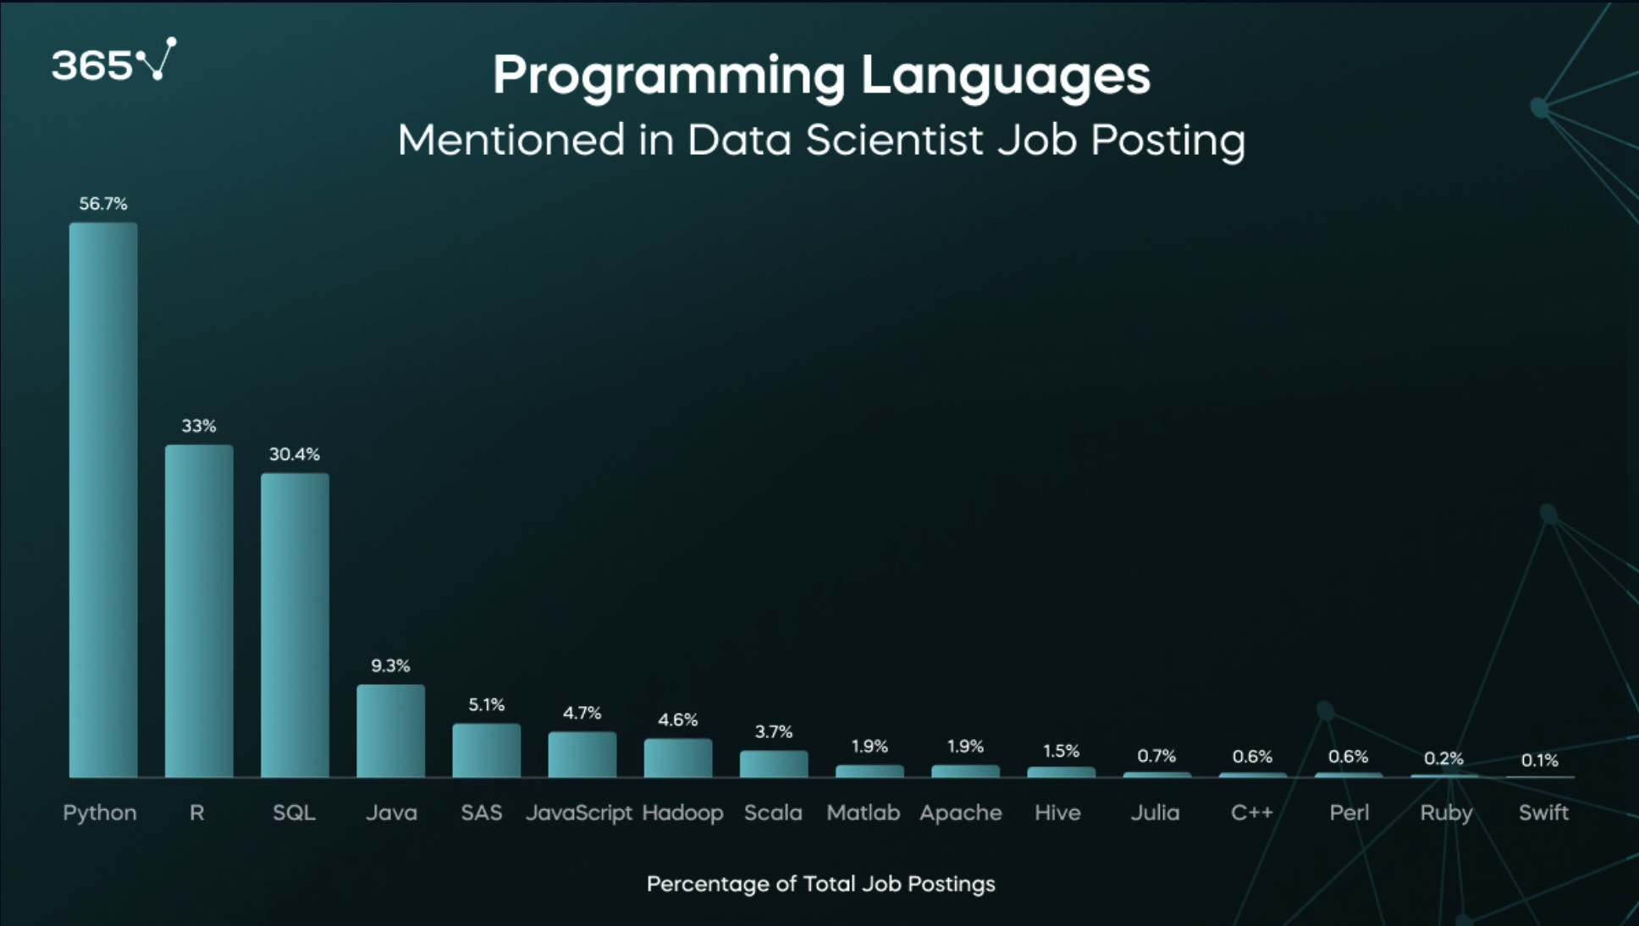
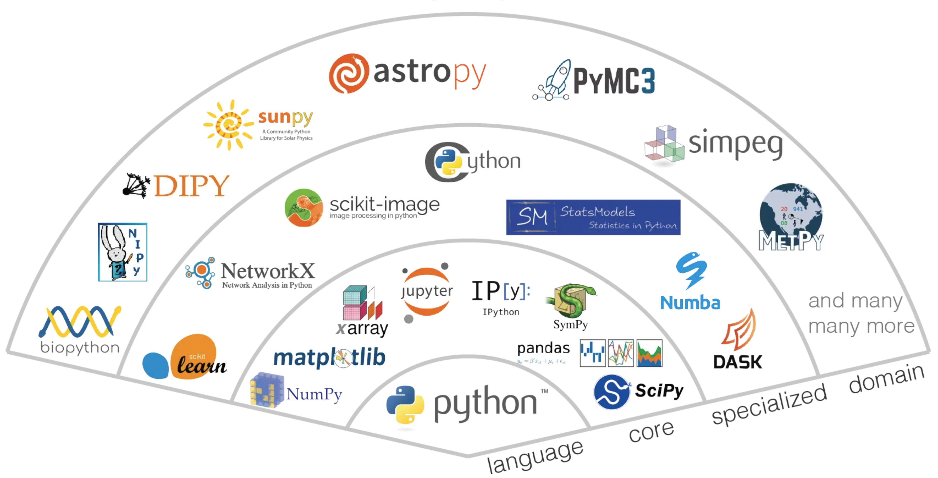
Why Python?
Most popular language in data engineering/data science, mathematics and DB, data engineering for AI, … …
Excellent packages, libraries and DB usage examples and tutorials.

Slide 17
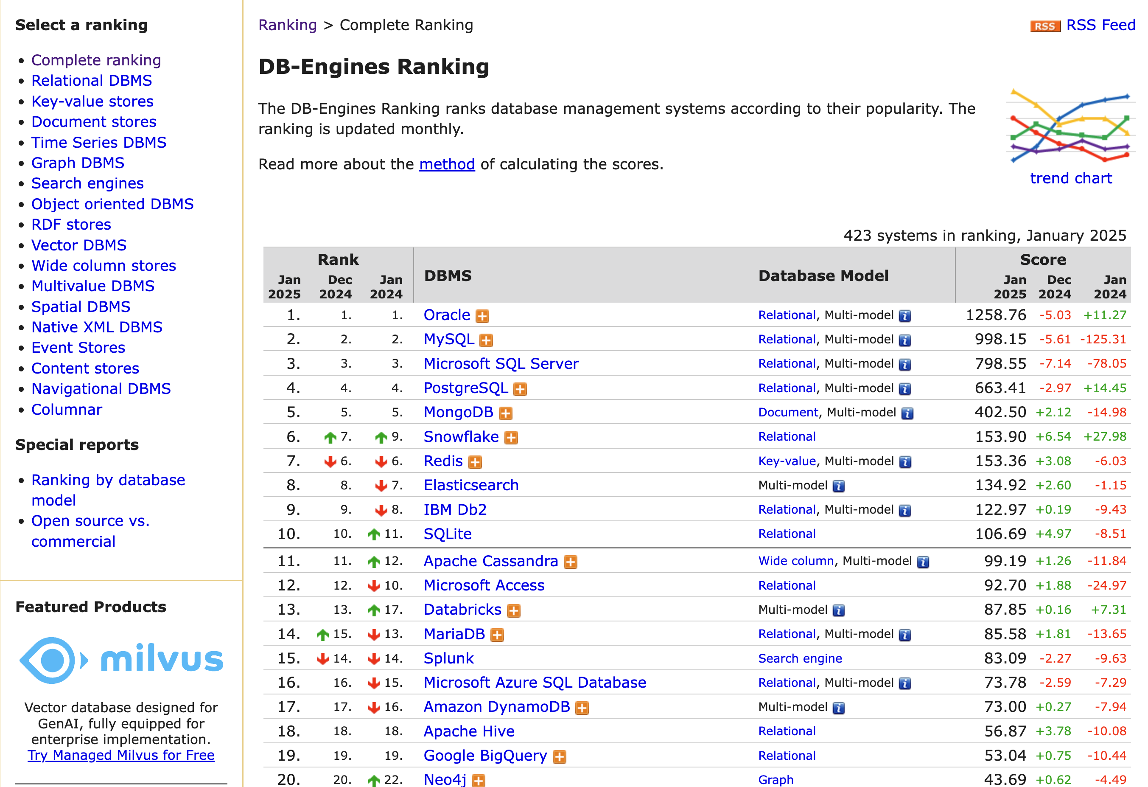
Which Databases?
MySQL is the most popular “open source, free” relational/SQL DBMS, but PostgreSQL is growing the fastest.
MongoDB is the most popular document DBMS.
Neo4j is the most popular Graph DBMS.
There are many technologies for data engineering and big data. PySpark is popular, common to many systems, simple to install and use from Python.
Note: Vector databases are growing rapidly because of generative AI/LLMs.

Slide 18
Contents

Slide 19
Course Overview

Slide 20

W4111 Introduction to Databases:
Faculty do not manage waitlists for some courses, including W4111.
The academic admin staff in the CS Department manages the waitlist, priorities and enrollment.
You should contact advising email:
ug-advising, ms-advising, or phd-advising @cs.columbia.edu
20 | COMS W4111_003_2024_3: Lecture 1: Introduction, Course Overview, Foundational Concepts © Donald F. Ferguson, 2024

Slide 21
W4111 Introduction to Databases:
Faculty do not manage waitlists for some courses, including W4111.
The academic admin staff in the CS Department manages the waitlist, priorities and enrollment.
You should contact advising email:
ug-advising, ms-advising, or phd-advising @cs.columbia.edu
21 | COMS W4111_003_2024_3: Lecture 1: Introduction, Course Overview, Foundational Concepts © Donald F. Ferguson, 2024

Slide 22
Contents
Introduction
Logistics, about your instructor, OHs, IAs.
Homework, exams.
Data, Databases, Database Management Systems, Applications
Motivating Examples:
Interactive, web application.
Data analysis and visualization.
Database design, Entity-Relationship Model (Part 1)
Database design process.
ER-Model and diagrams.
The theory: The Relational Model (Part 1)
Relational model, schema, keys, schema diagrams.
Basics of relational algebra.
The realization: Structured Query Language (SQL) (Part 1)
Basics of Data Definition Language.
Basics of Data Manipulation Language (Query).
Homework 1 – (Initial) Definition and discussion.
The material is mostly
History of databases
Motivation for databases
Terms
Concepts
Covering in lecture is not a good use of time.
Just read slides that come with book. https://www.db-book.com/slides-dir/index.html
Homework assignments and exams will test knowledge and if you have reviewed material.

Slide 23
